Slide 1
Sets
Course Code: CSC 1204
Course Title: Discrete Mathematics
Dept. of Computer Science
Faculty of Science and Technology
Lecturer No: | 7 | Week No: | 4 | Semester:
Lecturer: | Name & email

Slide 2
Lecture Outline
2.1 Sets
Definition of Set
Representation of a Set
Different Types of Sets
Standard Numerical Sets
∈-Notation
Venn diagram
Equal Set, Subset, Proper Subset, Cardinality of a Set, Super Set, Power Set, Ordered n-tuples, Cartesian Product of Sets

Slide 3
Objectives and Outcomes
Objectives: To understand Set, element/member of a Set, Representation of Set, different types of Sets, Set notations, Venn diagram, Cardinality of a set, Power set, Ordered n-tuples, Cartesian Product of Sets.
Outcomes: Students are expected to be able to explain different types of sets with examples, be able to understand different set notations, be able to draw Venn diagram, be able to find the cardinality and power set of a given set, be able to find the Cartesian product of sets.

Slide 4
Sets
Definition1: A set is an unordered collection of objects.
  Definition2: Objects in a set are called elements, or members of the set. A Set is said to contain its elements.
Capital letters (e.g. A, B, C, O, N) are ordinarily used to denote sets and lowercase letters (e.g., a, b, c, e) are used to denote elements of a sets.
Elements of a Set may NOT be the same type always!

Slide 5
Sets
A set is defined only by the elements which it contains. Thus, repeating an element, or changing the ordering of elements in the description of the set, does NOT change the set itself.
    A = {1, 2, 4} = { 1, 1, 1, 2, 2, 4, 4, 4, 4} = {2, 4,1}
Sets can have other sets as member.
  B = { a, {a, b}, {{x}}, y }

Slide 6
Representation of a Set
Basically, there are two ways of representing a set:
List notation/form: All elements of the set are listed, the elements being separated by commas(,) and are enclosed by curly braces “{“ and “}”
Example: B = { a, e, i, o, u}
A = { 2, 4, 6, 8}
Set builder notation/form, or, Rule method, : A set is defined by specifying a property that elements of the set have in common.
Example: B = { x| x is a vowel in the English alphabets}
A = { x| x is an even integer between 1 and 8}

Slide 7
Different Types of Sets
Empty set/ Null set: A set with no member is called empty/null set. Empty set is denoted by ∅. Empty set is also denoted by { }.
Examples: B = { }, A = { x is a multiple of 4 | x is odd }
      Note: ∅ ≠ {∅}
Singleton set: A set with one element is called a singleton set. Examples: B = {4} , S = {a}
Finite set : A set with finite number of elements in it, is called a finite set. Example: A = { 1, 3, 4,77}
Infinite set : An infinite set is a set which contains infinite number of elements.
Examples: N = { 0, 1, 2, 3, ……….}
B = { 1, 1/3, 1/9, 1/27, ………..}

Slide 8
Some Examples of Sets
{1, 2, 3} is the set containing elements “1” and “2” and “3.”
{1, 1, 2, 3, 3} = {1, 2, 3} since repetition is irrelevant.
{1, 2, 3} = {3, 2, 1} since sets are unordered (order of elements does NOT matter)
{0,1, 2, 3, …} is a way we denote an infinite set (in this case, the natural numbers).
∅ = {} is the empty set, or the set containing no elements.
A = { a, 2, Fred, New York } ==> Although elements are usually same type, but they may be of different types

Slide 9
Sets: More examples
Example 1 : The set V of all vowels in the English alphabet cab be written as V = { a, e, i, o, u }.
Example 2: The set O of odd positive integers less than 10 can be denoted by { 1, 3, 5, 7, 9 }.
Example 4 : The set of positive integers less than 100 can be denoted by { 1, 2, 3, ………..,99 }.

Slide 10
Standard Numerical Sets
N = {0, 1, 2, 3, …}, natural numbers
Z = {…,-2, -1, 0, 1, 2, …}, integers
Z⁺ = {1, 2, 3, …}, positive integers
Q = {p/q|p∈Z, q∈Z, and q≠0}, rational numbers
R = real numbers
The real numbers: R ==> contains any decimal number of arbitrary precision
The rational numbers: Q ==> these are decimal numbers whose decimal expansion repeats

Slide 11
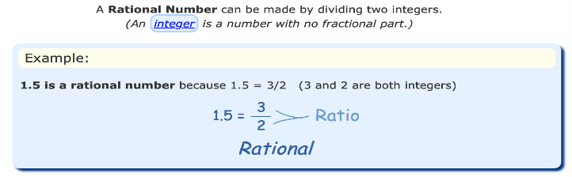
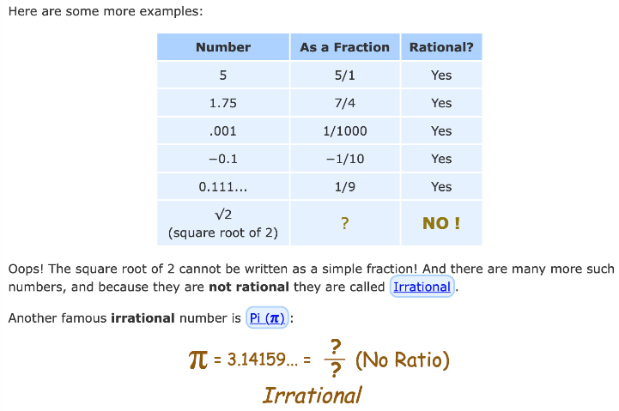
Standard Numerical Sets

Slide 12
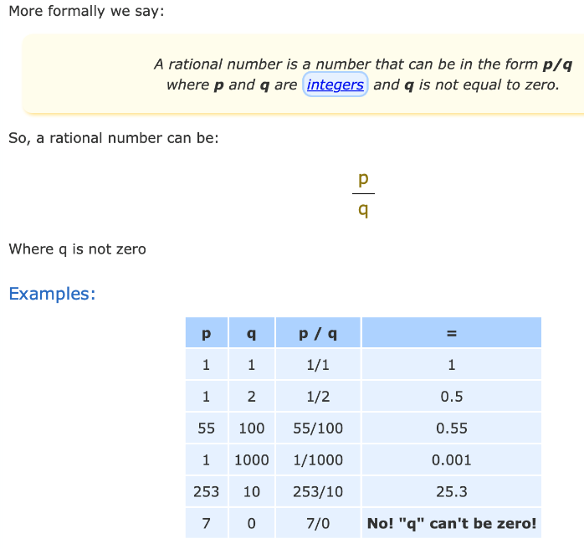
Standard Numerical Sets

Slide 13
∈-Notation
The Greek letter “∈” (epsilon) is used to denote that an object is an element of a set. When crossed out “∉” denotes that the object is not an element.”
Example: 3 ∈ S reads: “3 is an element of the set S ”.
3 ∉ S reads: “3 is not an element of the set S ”.
Q: Which of the following are true:
    3 ∈ R
    -3 ∈ N
    -3 ∈ R
    0 ∉ Z⁺
    ∃ x, x∈R ∧ x² = - 5

Slide 14
∈-Notation
Answers:
3 ∈ R. True: 3 is a real number.
−3 ∈ N. False: natural numbers don’t contain negatives.
−3 ∈ R. True: −3 is a real number.
0 ∉ Z⁺. True: 0 is NOT a positive integer.
∃x x∈R ∧ x² = −5 . False: square of a real number is non-negative, so can’t be −5.

Slide 15
Venn diagram
Sets can be represented graphically using Venn diagrams.
In Venn diagrams, the universal set U, which contains all the objects under consideration, is represented by a rectangle.
Note: the universal set varies depending on which objects are of interest
Inside the rectangle,
    − Circles or other geometrical figures are used to represent sets.
    − Sometimes points are used to represent the particular elements of the set.
Venn diagrams are often used to indicate the relationships between sets.

Slide 16
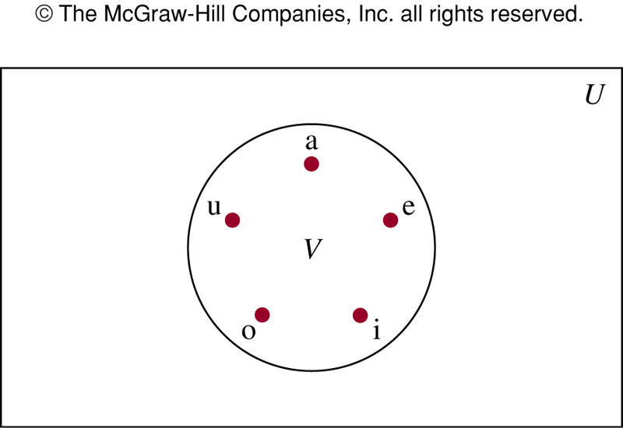
FIGURE 1
Venn Diagram for the Set of Vowels

Slide 17
Equal Set
Definition 3: Two sets are equal if and only if they have the same elements.
A = B iff ∀x(x ∈ A ↔ x ∈ B)
Two sets A and B are said to be equal if and only if every element of A is an element of B and consequently every element of B is an element of A; that is A ⊆ B and B ⊆ A and it is written as A = B
Example 6 (p.113) : The sets { 1, 3, 5} & { 3, 5, 1 } are equal because they have the same elements.

Slide 18
Subset
Definition 4: The set A is a subset of B if and only if every element of A is also an element of B.
We use the notation A ⊆ B to indicate that A is a subset of the set B.
A ⊆ B if and only if the quantification
∀x(x ∈ A → x ∈ B) is true
Note: Every non-empty set S is guaranteed to have at least two subsets, the empty set and the set S itself, that is ∅ ⊆ S and S ⊆ S

Slide 19
Subset
Theorem 1: For every non-empty set S,
  (1) ∅ ⊆ S, and
  (2) S ⊆ S
Note: If A⊆B and B⊆A, then A=B
Sets may have other sets as members
  A = {∅, {a}, {b}, { a, b} }
  B = { x | x is a subset of the set {a ,b } }
  Note: These two sets above are equal, that is, A = B
  Note : In the above example, {a} ∈ A, but a ∉ A

Slide 20
Proper Subset
Proper subset: Any subset A is said to be proper subset of another set B if A is a subset of B, but there is at least one element of B which does not belong to A,
i.e., if A⊆B but A ≠ B.
∀x(x ∈ A → x ∈ B) ∧ ∃x(x ∈ B ∧ x ∉ A)
A ⊂ B means “A is a proper subset of B.”
Example: A = { 1, 5 }, B = { 1, 5, 6}
Here, A is a proper subset of B, i.e., A ⊂ B

Slide 21
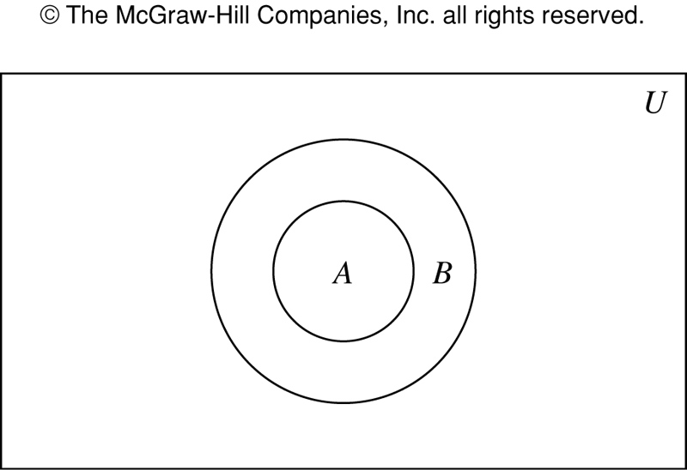
FIGURE 2 Venn Diagram Showing that
A is a Subset of B

Slide 22
Cardinality of a Set
Definition: If there are exactly n distinct members in the set S (n is a nonnegative integer), we say that S is a finite set and that n is the cardinality of S.
The cardinality of a set is the number of distinct elements in the set.
|S| denotes the cardinality of set S that has n number of elements; i.e., |S|= n
Examples:
    |∅|= 0
    | { 1, 5, 7, 8}|= 4

Slide 23
Cardinality of a Set
Question: Compute cardinality of each of the sets.
    {1, -13, 4, -13, 1}
    {3, {1,2,3,4}, ∅}
    {}
    { {}, {{}}, {{{}}} }
Hint: After eliminating the repetitions/redundancies just count the number of top level commas and add 1 (except for the empty set).

Slide 24
Answers
  |{1, -13, 4, -13, 1}| = |{1, -13, 4}| = 3
  |{3, {1,2,3,4}, ∅}| = 3
  |{}| = |∅| = 0
  |{ {}, {{}}, {{{}}} }| = |{ ∅, {∅}, {{∅}}| = 3

Slide 25
Cardinality of a Set: More examples
Example 9: Let A be the set of odd positive integers less than 10. Then |A| = 5
Example 10: Let A be the set of letters in the English alphabet. Then |A| = 26
Example 11: Because null set has no elements, it follows that, |∅| = 0
Examples:
  The cardinality of the set {∅} is 1, i.e., |{∅}| = 1
  If B = {3,3,3,3,3}, |B| = 1
  If C = { ∅, {∅}, {∅,{∅}} }, | C | = 3.
  If S = {0,1,2,3,…}, |S| is infinite

Slide 26
Super Set
If A is a subset of B, then B is called the super set of A and written as B ⊇ A which is read as “B is a super set of A”.
A ⊇ V means “A is a superset of V.”
Example: { 1, 4, 7, 8} is a superset of the set { 4, 7 }

Slide 27
Quick Examples
{1,2,3} ⊆ {1,2,3,4,5} Yes/No?
{1,2,3} ⊂ {1,2,3,4,5} Yes/No?
Is ∅ ⊆ {1,2,3}? Yes!
Is ∅ ∈ {1,2,3}? No!
Is ∅ ⊆ {∅,1,2,3}? Yes!
Is ∅ ∈ {∅,1,2,3}? Yes!

Slide 28
Empty set in not an element of every set
The empty set is a subset of every set. This is because every element in the empty set is also in set A. Of course, there are no elements in the empty set, but every single one of those zero elements is in A.
The empty set is not an element of every set. It may be an element of some sets; for example, the set 1,2,{},51,2,{},5 has the empty set as one of its elements. However, the set 1,2,3,51,2,3,5 does not contain the empty set as an element. In particular, the empty set is not an element of itself, for the simple reason that the empty set has no elements at all.

Slide 29
Quiz: Yes/No?
Is {x} ⊆ {x}?
Is {x} ∈ {x,{x}}?
Is {x} ⊆ {x,{x}}?
Is {x} ∈ {x}?
Answer: 1. Yes 2. Yes 3. Yes 4. No

Slide 30
Power Set
Definition : The power set of S is the set of all subsets of the set S.
We say, “P(S) is the set of all subsets of S”
The power set of S is denoted by P(S)
Note: If a set has n elements, then its power set has 2^{n} elements.

Slide 31
Power Set: Examples
Example 13: What is the power set of the set {0,1,2 } ?
Solution: The power set P ( { 0, 1, 2 } ) is the set of all subsets of
{ 0, 1, 2 } . Hence,
P ( { 0, 1, 2 } ) = {∅, {0}, {1}, {2}, {0,1}, {0,2}, {1,2}, { 0,1,2}}
Example 14: What is the power set of empty set? What is the power set of the set {∅} ?
Solution:
  P(∅) = {∅}
  P( {∅} ) = { ∅, {∅} }

Slide 32
Ordered n-tuples
The order of elements in a collection is often important. Because sets are unordered, a different structure is needed to represent ordered collections. This is provided by ordered n-tuples.
Definition : The Ordered n-tuple (a₁, a₂, …, a_{n}) is the ordered collection that has a₁ as its first element, a₁ as its second element, ……….and a_{n} as its nth element.

Slide 33
Ordered n-tuples
Two ordered n-tuples are equal if and only if each corresponding pair of their elements is equal.
In other words, (a₁, a₂ , ….., a_{n}) = (b₁ , b₂ , …….., b_{n} )
if and only if a_{i =} b_{i} for i = 1, 2, ……, n
2-tuples are called ordered pairs. The ordered pairs
(a, b) and (c, d) are equal if and only if a = c and b = d
Note: (a, b) and (b, a ) are not equal unless a = b

Slide 34
Ordered n-tuples
Notationally, n-tuples look like sets except that
curly braces are replaced by parentheses.
As opposed to sets, repetition and ordering do matter with n-tuples.
  (11, 11, 11, 12, 13) ≠ ( 11, 12, 13 )
  But, {11, 11, 11, 12, 13} = {11, 12, 13}
Note:
  For set, we use { }
  For n-tuples, or ordered pairs, we use ( )

Slide 35
Cartesian Product of Sets
Definition : Let A and B be sets. The Cartesian product of A and B, denoted by A × B, is the set of all ordered pairs (a, b), where a ∈ A and b ∈ B.
A × B = {(a, b)| a ∈ A ∧ b ∈ B}

Slide 36
Cartesian Product of Sets: Example
Example 16: What is the Cartesian product of A = { 1, 2 } and
B = { a, b, c} ?
Solution:
A X B = { (1,a), (1,b), (1,c), (2,a), (2,b), (2,c) }
  Note : A× B and B× A are not equal, unless A=∅ or B=∅ or A=B
  Note: Cartesian product of more than two sets can be defined
  Note: A subset R of the Cartesian product A X B is called a Relation from the set A to the set B (Relation will be covered in the final term)
Practice @ Home: Example 17

Slide 37
Example:
Cartesian Product of Three Sets
Question: If A = {1,2}, B = {3,4}, C = {5,6,7}, what is A ×B ×C ?
Solution:
A ×B ×C = { (1,3), (1,4), (2,3),(2,4)} × {5,6,7}
= { (1,3,5), (1,3,6), (1,3,7),(1,4,5), (1,4,6), (1,4,7),
(2,3,5), (2,3,6), (2,3,7), (2,4,5), (2,4,6), (2,4,7) }
Note: |A ×B ×C | = |A|.|B|.|C| = 2.2.3 = 12
Practice @ Home: Example 18

Slide 38
Practice @ Home
Relevant odd-numbered Exercises from your text book
Exercises: 1, 3, 5, 7, 9, 11, 13, 15, 17, 19, 23, 27, 29, 33, 35

Slide 39
Books
Discrete Mathematics and its applications with combinatorics and graph theory (7th edition) by Kenneth H. Rosen [Indian Adaptation by KAMALA KRITHIVASAN], published by McGraw-Hill

Slide 40
References
Discrete Mathematics, Richard Johnsonbaugh, Pearson education, Inc.
Discrete Mathematical Structures, Bernard Kolman, Robert C. Busby, Sharon Ross, Prentice-Hall, Inc.
SCHAUM’S outlines Discrete Mathematics(2nd edition), by Seymour Lipschutz, Marc Lipson

